Slide 1
The Cloud computing

Slide 2
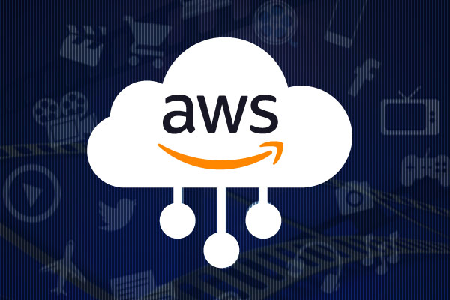
AWS cloud
AWS Cloud Computing is the on-demand delivery of it resources over the internet with pay-as-you-go pricing.
Instead of buying, owning and maintaining physical data centers and servers, you can access technology services, such as computing, power, storage, and databases, on an as-needed basis from a cloud provider like amazon web services (aws).
Types of cloud : Public, Private, Hybrid

Slide 3
Services of Cloud computing
Iaas (infrastructure as A service): Iaas contains the basic building blocks for cloud IT. It typically provides access to networking features, computers (virtual or on dedicated hardware), and data storage space. Iaas gives you the highest level of flexibility and management control over your IT resources. It is most similar to the existing IT resources with which many IT departments and developers are familiar.
Paas (platform as a service): Paas removes the need for you to manage underlying infrastructure (usually hardware and operating systems), and allows you to focus on the deployment and management of your applications. This helps you be more efficient as you don’t need to worry about resource procurement, capacity planning, software maintenance, patching, or any of the other undifferentiated heavy lifting involved in running your application.
SaaS(Software as a Service): SaaS provides you with a complete product that is run and managed by the service provider. In most cases, people referring to SaaS are referring to end-user applications (such as web-based email). With a SaaS offering, you don’t have to think about how the service is maintained or how the underlying infrastructure is managed. You only need to think about how you will use that particular software.

Slide 4
Components
Amazon EC2
AWS Lambda
Amazon EBS (Elastic Block Store)
Amazon RDS (relational database service)
Amazon VPC (Virtual Private Cloud)
AWS IAM (Identity and Access Management)

Slide 5
Aws lambda
It allows you to run code without the need to provision or manage servers.
It is commonly used for tasks like data processing, real-time file processing, image resizing, and handling backend logic for web and mobile application.
AWS lambda follows the serverless computing model, where developers focus on writing code without dealing with the underlying infrastructure. The service automatically handles server provisioning, scaling, and maintenance.

Slide 6
Amazon ebs(Elastic block storage)
It is a scalable block storage service provided by amazon web services (AWS).
It is designed to provide persistent block-level storage volumes for use with amazon EC2 instances.
It presents storage volumes as raw block devices to EC2 instances. Users can format these volumes with their preferred file system and install applications or databases on them.

Slide 7
Amazon vpc (virtual private cloud)
It is a networking service provided by amazon web services (AWS) that allows users to create isolated, private networks within the AWS cloud.
Amazon VPC enables users to define their own virtual network environment, including IP address ranges, subnets, route tables, and network gateways.
It acts as a private network in the cloud, providing control over network configurations.

Slide 8
AWS IAM (Identity and Access Management)
It is a web service provided by amazon web services (AWS) that enables users to securely control access to AWS services and resources.
IAM allows organizations to manage users, groups, and permissions within their AWS environment.
IAM is a fundamental component of AWS security, providing a robust and flexible framework for managing identities and controlling access to AWS resources.

Slide 9
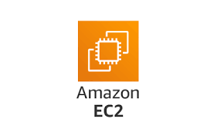
Amazon EC2
Amazon elastic compute cloud (amazon EC2) provides virtual machines where you can host the same kinds of applications that you might run on a traditional on-premises server.
It provides secure, resizable compute capacity in the cloud. EC2 instances can support a variety of workloads.

Slide 10
Components of Amazon EC2
Instances:
An EC2 instance is a virtual server in the cloud that runs the chosen operating system. Users can choose from a variety of instance types based on their specific needs, such as compute-optimized, memory-optimized, storage-optimized, or GPU instances. Instances form the foundation of the compute capacity that users can provision and use within EC2.
Amazon machine images (amis):
An AMI is a pre-configured template that contains the necessary information to launch an EC2 instance. It includes the operating system, application server, and any additional software configurations. Users can choose from a variety of public amis provided by AWS or create their own custom amis.

Slide 11
Security groups:
Security groups act as virtual firewalls for EC2 instances, controlling inbound and outbound traffic. Users can define rules within security groups to specify the allowed traffic based on protocols, ports, and source/destination IP addresses. Each EC2 instance is associated with one or more security groups.
Key pairs:
Key pairs are used for securely connecting to EC2 instances. When launching an EC2 instance, users specify a key pair, and the public key is stored on the instance. Users with the corresponding private key can then connect to the instance securely using SSH (for linux instances) or remote desktop protocol (RDP for windows instances).
Elastic block store (ebs):
Amazon EBS provides scalable block storage volumes that can be attached to EC2 instances. EBS volumes are used for persistent data storage, allowing data to persist even if the associated EC2 instance is stopped or terminated. Users can choose different types of EBS volumes based on performance requirements.

Slide 12
Thank you

